Slide 1

Plotly for grad school
By Tylman Michael

Slide 2
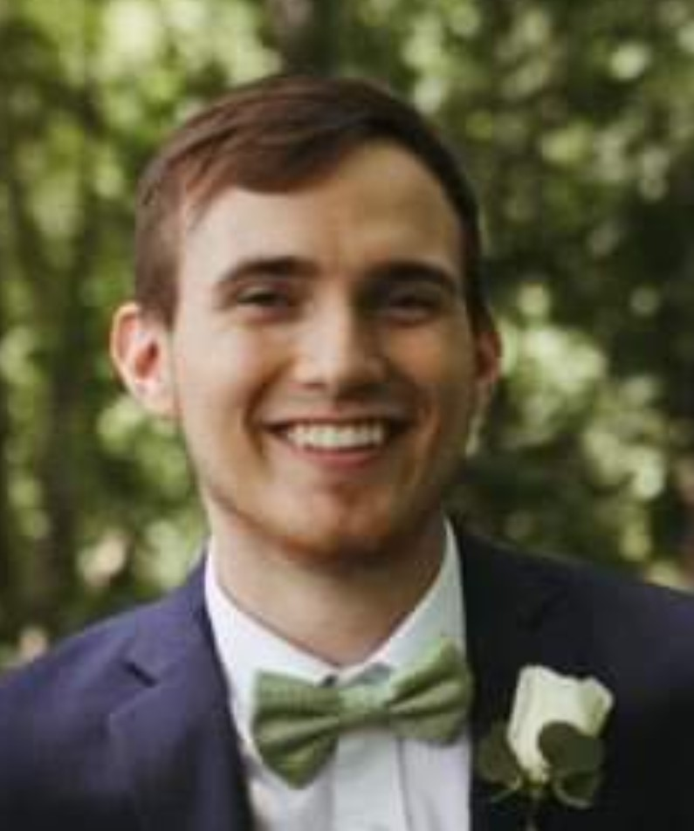
Introduction
Graduated in May with my Master’s from UofL
Senior Computational Biology Software Engineer
St. Jude Children’s Research Hospital

Slide 3
Introduction
About Me
About this Presentation
Graduated in May with my Master’s from UofL
Senior Computational Biology Software Engineer at St. Jude Children’s Research Hospital
Geared towards helping students
Minimal PowerPoint time
Interactive Jupyter notebook
Code will be made available for you to copy Reference

Slide 4

3 main takeaways
Organizing Data With Pandas*
Quick Plots With Plotly Express
Custom Plots With Graph Objects

Slide 5

Disclaimer on Organizing data with pandas
The pre-requisite for everything else discussed here
Numerous Data organization preferences and techniques exist that will not be covered here
A few helpful “rules” to get you started are included in the Notebook

Slide 6

Thank You

